Slide 1
OWASP Juice Shop Vulnerabilities
Improper Input Validation & Broken Authentication

Slide 2
Improper Input Validation - Admin Registration
Vulnerability: Lack of server-side validation allows setting admin role during registration.
Steps:
Register a new user and intercept request.
Submit a POST request to http://localhost:3000/api/Users with:
Modify JSON payload: "role": "admin".
Forward request and login as admin.

Slide 3
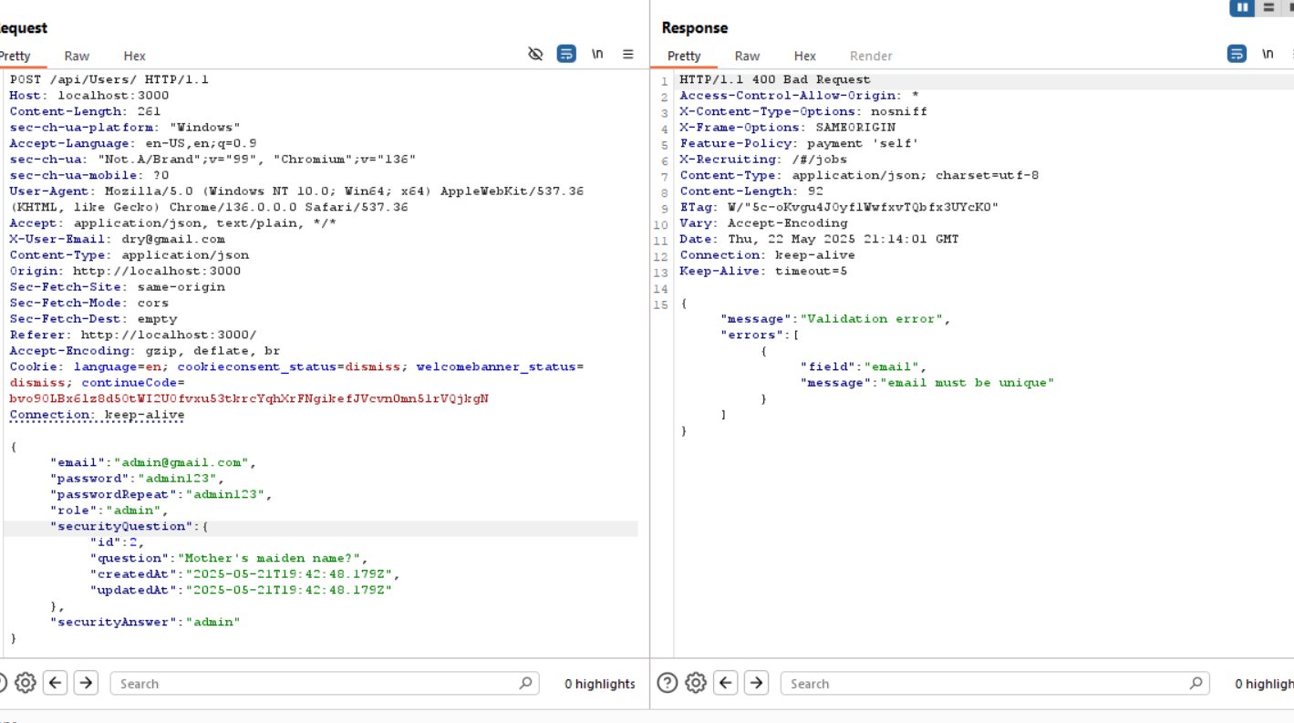

Slide 4
Improper Input Validation - Deluxe Fraud
Vulnerability: Client-side validation can be bypassed to activate deluxe membership for free.
Steps:
Go to deluxe membership page.
http://localhost:3000/#/payment/deluxe
Enable disabled payment options using dev tools.
Intercept and modify payment mode by removing wallet.
Forward request and confirm deluxe status.

Slide 5
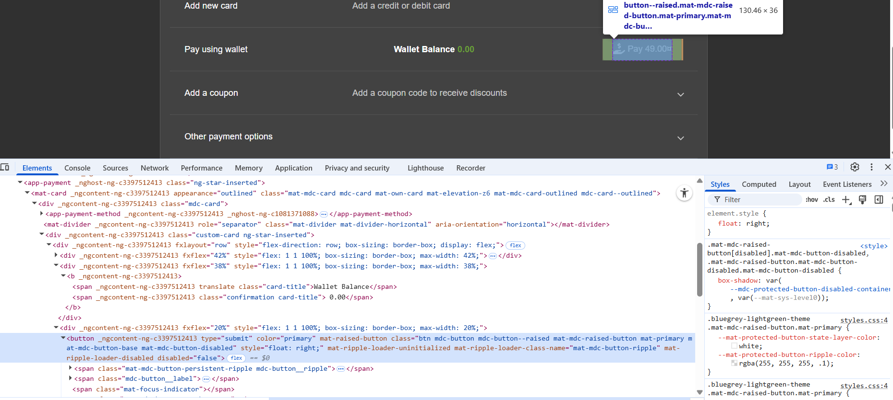

Slide 6
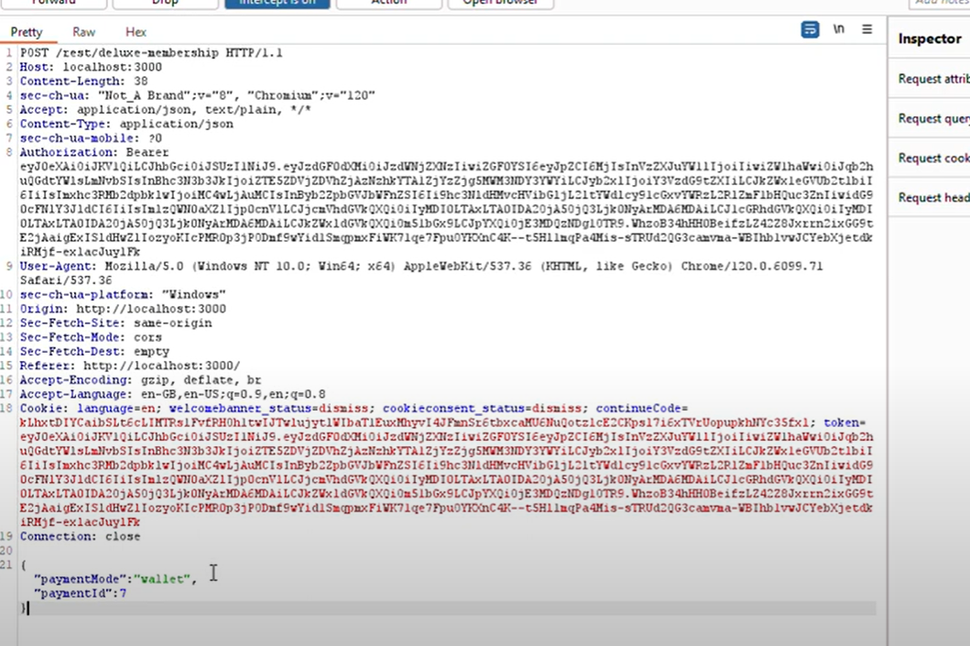

Slide 7
Improper Input Validation - Empty User Registration
Vulnerability: Allows registration with empty credentials.
Steps:
Intercept registration request.
Change email and password fields to empty.
Forward request to register empty user.

Slide 8
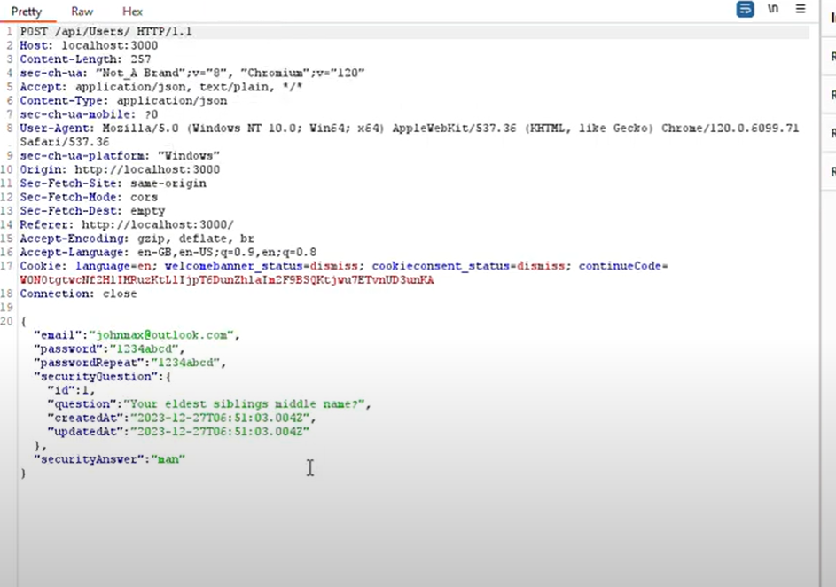

Slide 9
Improper Input Validation - Expired Coupon
goal is to successfully redeem an expired campaign coupon code in Juice Shop.
The app once offered seasonal coupons, and one such code (WMNSDY2019) is no longer valid — unless you trick the system by manipulating your local time.
Vulnerability Type
Client-Side Time Validation
The app uses the client’s system time (not the server time) to validate whether a coupon is active. This means a user can manipulate their local date to fool the app into accepting expired coupons.

Slide 10
Steps to Exploit and Solve the Challenge
Open Browser Dev Tools:
Go to the Juice Shop app in your browser.
Open the DevTools (usually F12 or Ctrl+Shift+I).
Open the Sources tab and locate the file: main.js.
Search for campaigns in main.js.
You will find a definition like this.campaigns = { WMNSDY2019: { ... } }.
Locate the validOn field (e.g., validOn: 15519996e5), which is a timestamp.
Convert the Timestamp:
Use JavaScript in the browser console:
Date(1551999600000)
This tells you the coupon was valid on March 8, 2019
Try Submitting the Coupon (it will fail initially):
Go to the cart and enter WMNSDY2019 as the coupon.
It will show "Invalid Coupon", because your system date is not March 8, 2019.
Manipulate System Time:
Change your local system date to March 8, 2019.
On Windows/macOS/Linux, manually set the system date/time via settings.
Refresh and Resubmit the Coupon and Reload the Juice Shop page.
Enter the coupon WMNSDY2019 again. This time it will be accepted!
Complete Checkout:
Proceed to checkout and place the order.
The challenge will be marked as solved.

Slide 11
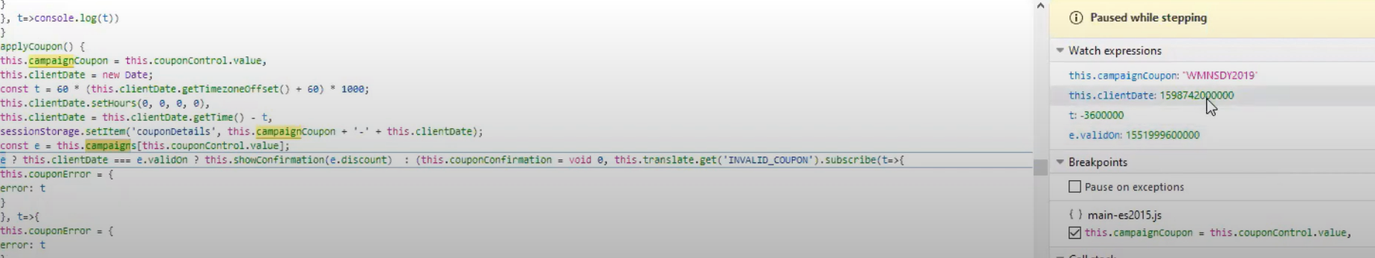

Slide 12
Improper Input Validation - Missing Encoding
Vulnerability: Poor URL encoding allows access to restricted files.
Steps:
Open Photo Wall: Go to http://localhost:3000/#/photo-wall in your browser.
Inspect Broken Image: Right-click the broken image labeled "😼 #zatschi #whoneedsfourlegs" and choose Inspect.
Check Image Tag: Look for the <img> tag in the code. You'll see that the image source URL includes # characters.
Identify the Issue: URLs with # symbols break because the browser ignores everything after the first #. These need to be encoded as %23.
Fix and Solve: Replace # with %23 in the URL (you can use CyberChef), then access the corrected link. This will solve the challenge.

Slide 13
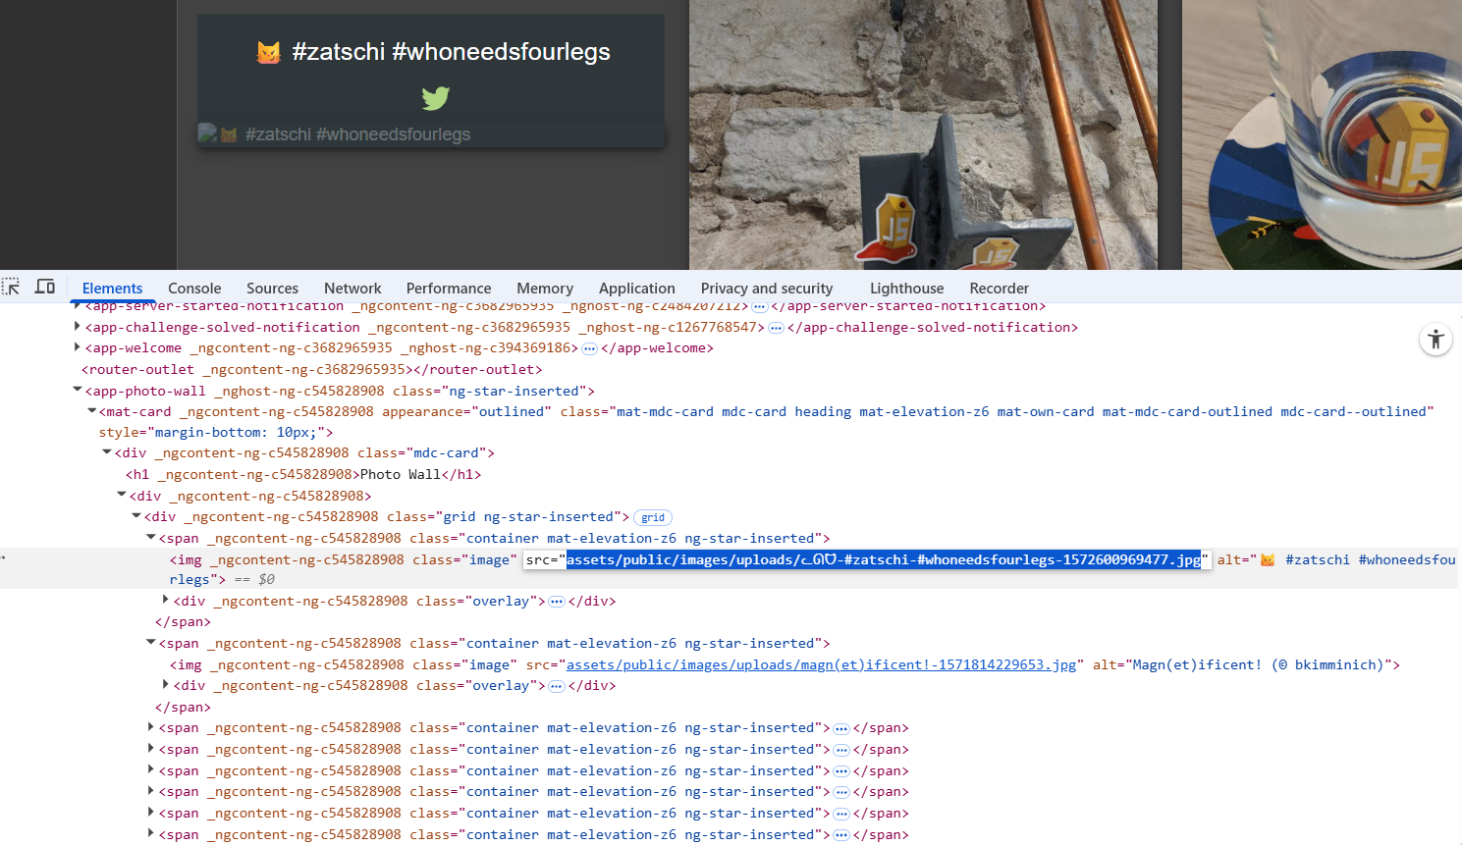

Slide 14
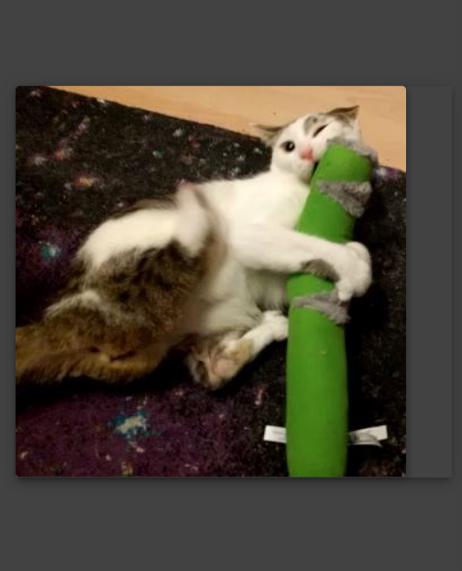

Slide 15
Improper Input Validation - Payback Time
Vulnerability: One of the worst fears for any online store is the possibility that customers could discover a way to get paid instead of being charged for their orders.
Steps:
Create customer and login
Add item to basket and make intercept request on and .
Change quantity to negative value and intercept off .
Proceed to checkout with negative total.

Slide 16
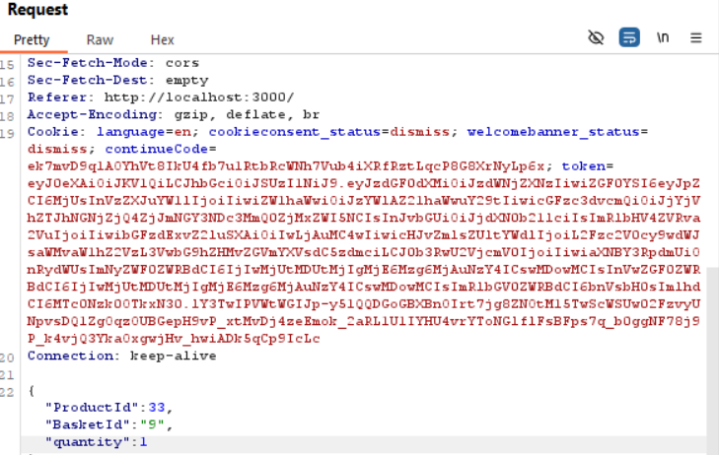

Slide 17
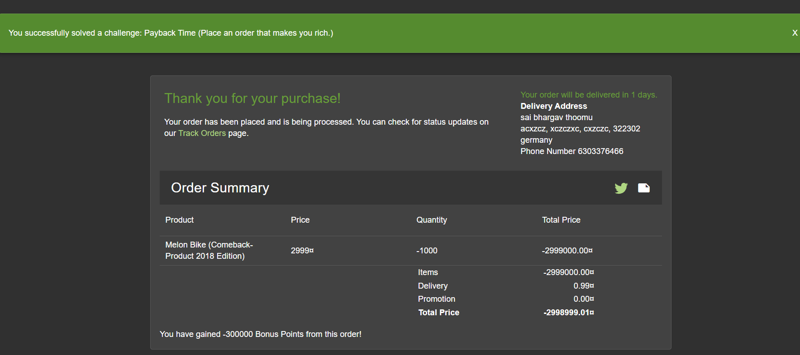

Slide 18
Improper Input Validation - Repetitive Registration
Vulnerability: Password and repeat password mismatch allowed.
Follows DRY principle while registring users
DRY states every piece of knowledge must have a single, unambiguous, authoritative representation within a system
Steps:
Open Registration Page: Visit http://localhost:3000/#/register.
Fill in the Form: Enter all required details except the Password and Repeat Password fields.
Enter Matching Passwords: Type a password in the Password field, then type the same in the Repeat Password field. You'll briefly see "passwords do not match" errors while typing, which disappear once both fields match.
Change Password: Go back and change the Password field to something else. Notice the Repeat Password field doesn't show a mismatch error even though the passwords no longer match.
Submit the Form: Click Register to submit the mismatched passwords. This flawed validation will let you register and solve the challenge.

Slide 19
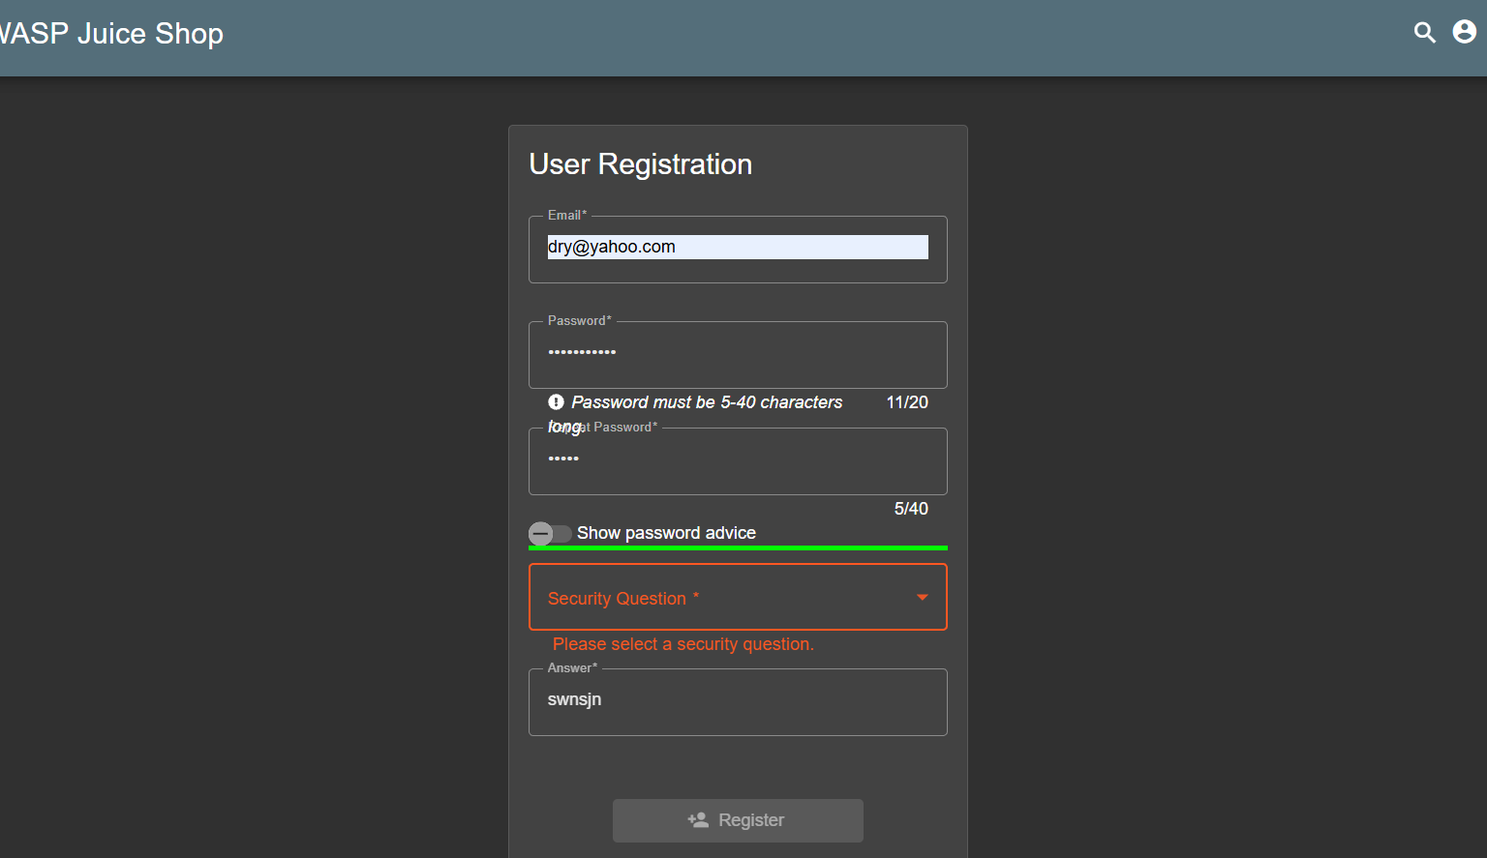

Slide 20
Improper Input Validation - Upload Size
Vulnerability: Large files bypass size restrictions.
Complaint Feature: Juice Shop lets customers file complaints about issues like late deliveries or damaged items (e.g., leaking juice bottles).
File Upload Restriction: To support their complaint, users must upload an order confirmation file, but it must be 100 kB or smaller to prevent misuse
Steps:
Upload file <100KB and intercept request POST request to http://localhost:3000/file-upload.
Modify pdf content with new pdf content more than 100kB.
Forward request to upload large file.

Slide 21
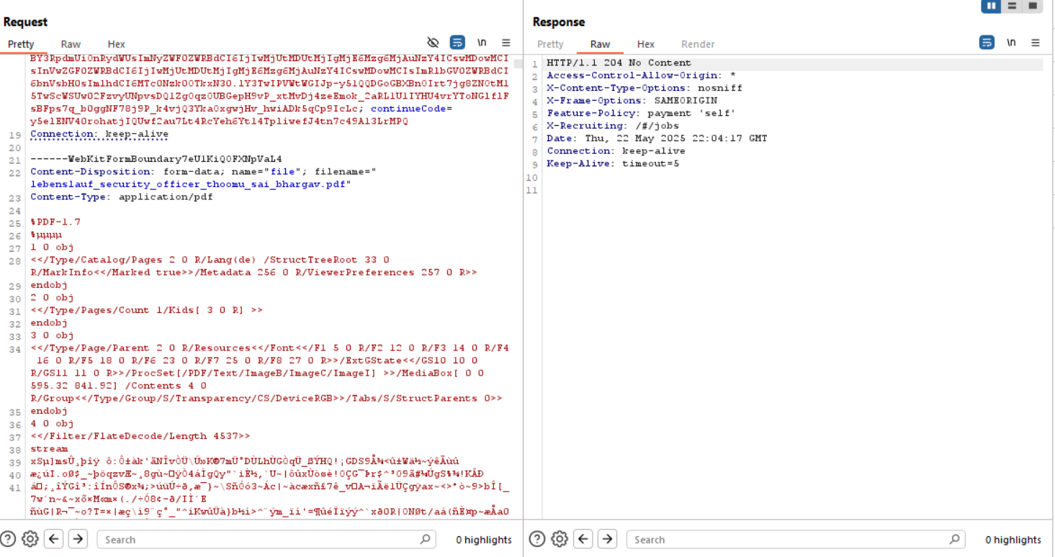

Slide 22
Improper Input Validation - Upload Type
Vulnerability: File type restrictions bypassed via extension change.
Steps:
Upload file <100KB and intercept request POST request to http://localhost:3000/file-upload.
Modify pdf content with new image png content and also modify its extension to .png.
Forward request to upload file of different type.

Slide 23
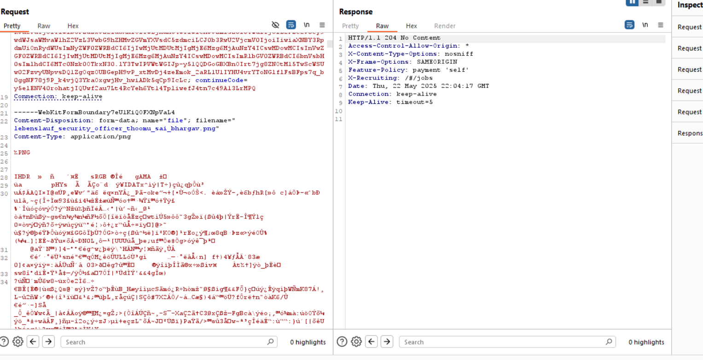

Slide 24
Improper Input Validation - Zero Stars
Vulnerability: The application normally requires users to provide both a comment and a star rating (between 1 and 5). However, the challenge is to bypass this restriction and successfully submit feedback with a 0-star rating.
Steps:
Submit feedback and make intercept on.
Get post request and modify rating to 0.
Forward and record zero-star rating.

Slide 26
Broken Authentication - Bjoern's Favorite Pet
The challenge involves resetting the password for the user bjoern@owasp.org by answering his security question: "Name of your favorite pet?". Although there is no technical flaw here, the real issue lies in the weakness of security questions — in this case, the answer can be easily discovered from public social media content.
Vulnerability: Weak Security Question
This scenario exposes a security design flaw in the use of personal knowledge-based authentication:
Publicly Available Info: The answer to the security question ("Zaya") is publicly available on Bjoern's Twitter profile via posts and photos.
Social Engineering Risk: Many people reuse personal facts (pet names, birthdays, etc.) for security questions, making it easy for attackers to exploit.
Steps
Start Password Reset
Go to: http://localhost:3000/#/forgot-password
Enter: bjoern@owasp.org
Check the Security Question
The question is: "Name of your favorite pet?"

Slide 27
Find the Answer on Social Media
Visit Bjoern’s Twitter: @bkimminich
Locate tweets showing his cat, specifically
The pet's name mentioned is Zaya.
Complete Password Reset
Go back to http://localhost:3000/#/forgot-password
Enter bjoern@owasp.org again
Input Zaya as the answer
Enter any new password and confirm it
Click Change to reset and solve the challenge

Slide 28
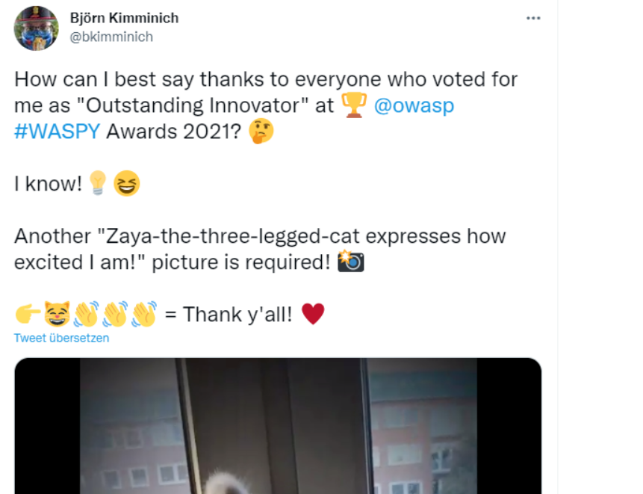

Slide 29
Broken Authentication - Change Bender's Password
The goal is to change Bender’s password to slurmCl4ssic without using SQL injection or the Forgot Password feature. By analyzing how the password change API behaves, we can discover a flaw in the request validation process. Using Burp Suite, we can exploit this behavior by manually sending a crafted GET request.
Vulnerability: Missing Authentication Checks
The endpoint /rest/user/change-password accepts GET requests with password parameters in the URL query.
It does not require the current password if omitted, and still allows the password to be changed.
Steps (using Burp Suite)
Log in as Any User
Sign in with any valid Juice Shop account (to observe the request structure).
Intercept a Password Change Request
Go to the Change Password form in the UI.
In Burp Suite, enable Intercept and capture the request when you try to change the password.
Observe the request URL:GET /rest/user/change-password?current=oldpass&new=newpass&repeat=newpass
Test for Vulnerabilities

Slide 30
Send the request to Burp Repeater.
Try removing current from the URL, so it looks like:
/rest/user/change-password?new=testpass&repeat=testpass
Send the request — if it returns 200 OK, the flaw exists.
Log in as Bender Using SQL Injection (just to get the token)
Use SQL Injection in the login form (e.g., ' OR 1=1--) with the username set to bender@juice-sh.op to bypass authentication.
Capture the Bearer token from the login response or headers.
Send Exploit Request in Repeater
In Burp Repeater, create a new GET request to:
http://localhost:3000/rest/user/change-password?new=slurmCl4ssic&repeat=slurmCl4ssic
Hit Send. If the response is 200 OK and shows Bender’s user object, the password has been successfully changed.

Slide 31
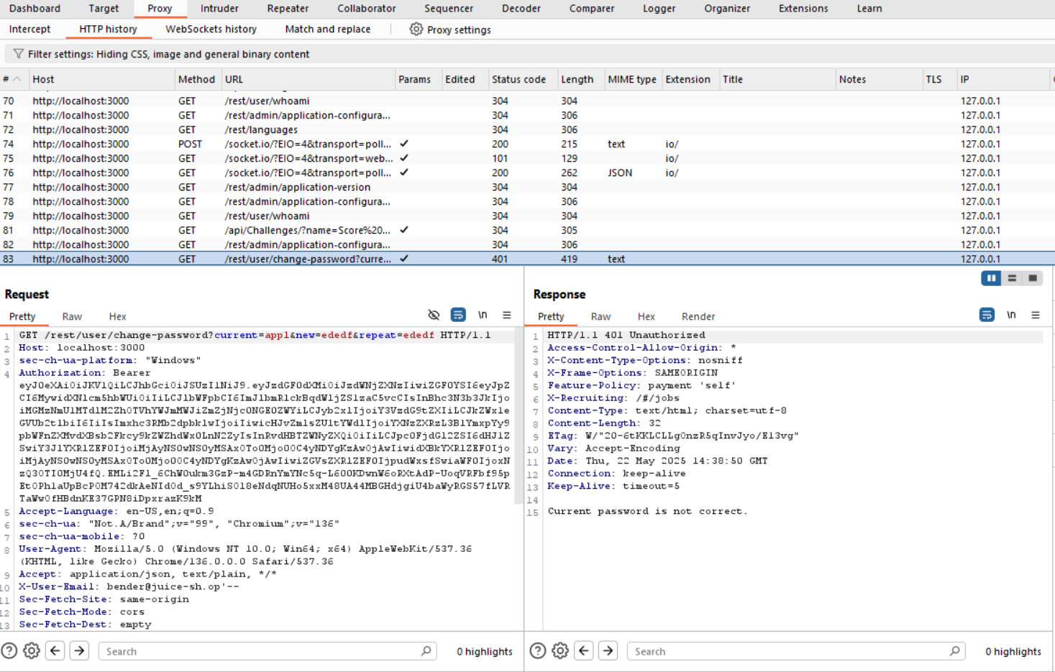

Slide 32
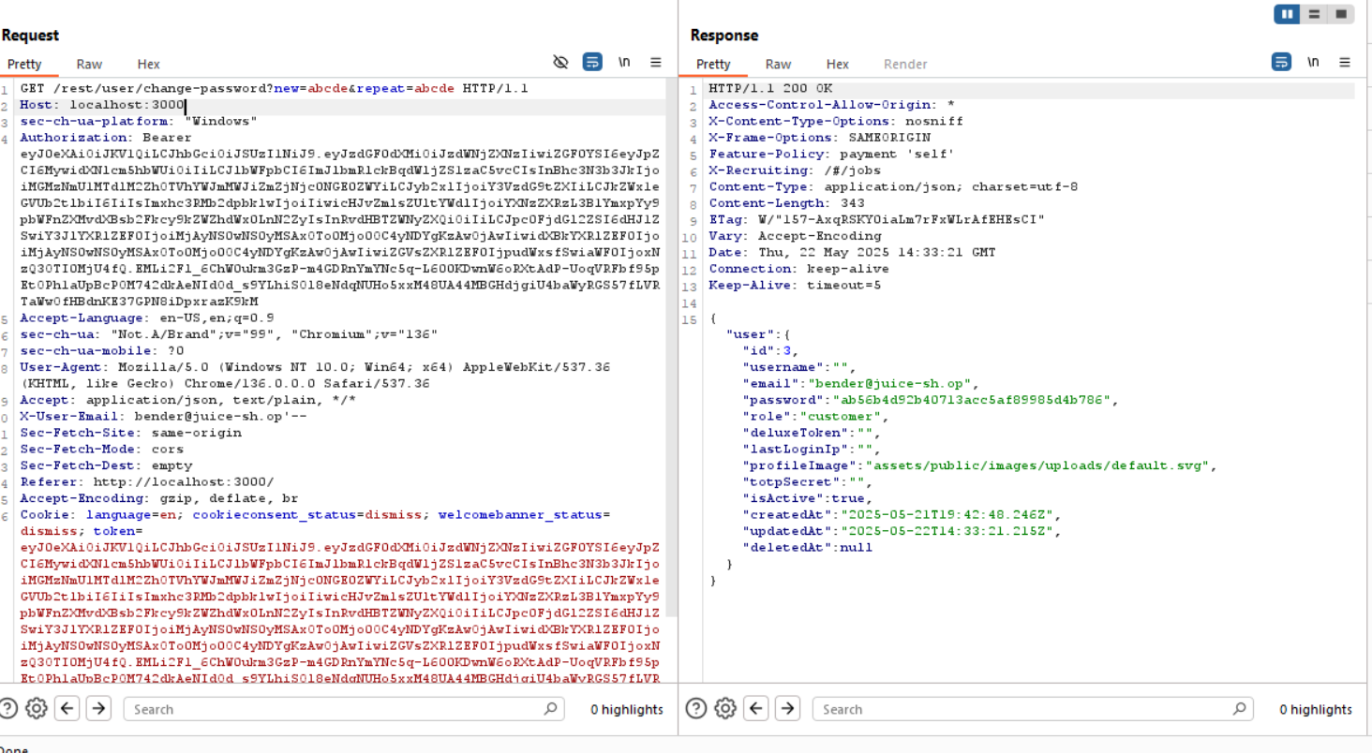

Slide 33
Broken Authentication - Login Bjoern
The author of Juice Shop, Bjoern Kimminich, linked his Google account (bjoern.kimminich@googlemail.com) to the application using OAuth. While the "Log in with Google" button might not be available in your environment due to host restrictions, the login process still uses a predictable method to create and authenticate OAuth-based accounts.
By examining the code, we find that the application sets the password for OAuth users by reversing their email and encoding it with Base64. With this knowledge, you can log in directly using the derived password.
Vulnerability: Predictable Password Generation for OAuth Users
OAuth accounts are initialized with a deterministically generated password based on the user’s email.
Specifically, the password is generated using:
btoa(email.split("").reverse().join(""))
Which means: reverse the email string and encode it in Base64.
This creates a predictable password that can be reproduced by anyone with access to the email

Slide 34
Steps
1. Discover the Password Logic
Open main.js in Juice Shop in Devloper tools byb inspecting.
Search for oauth.
Inside that function, observe this line:
password: btoa(n.email.split("").reverse().join(""))
Understand it as: reverse the email, then Base64 encode the result.
Apply the Logic to Bjoern’s Email bjoern.kimminich@googlemail.com
Reversed:
moc.liamelgoog@hcinimmik.nreojb
Base64 encode the reversed string:
Result: bW9jLmxpYW1lbGdvb2dAaGNpbmhtaW1tay5ucmVvamI=
3. Log in with the Generated Credentials
Go to: http://localhost:3000/#/login
Email: bjoern.kimminich@googlemail.com
Password: bW9jLmxpYW1lbGdvb2dAaGNpbmhtaW1tay5ucmVvamI=

Slide 35
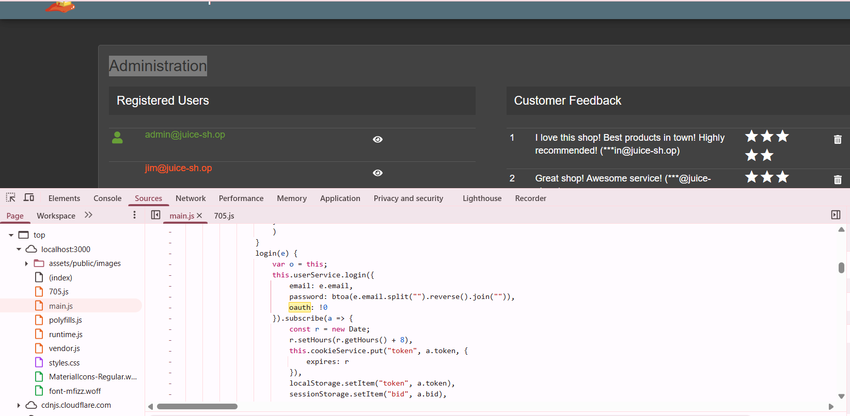

Slide 37
Broken Authentication - Password Strength
Vulnerability: Weak default admin passwords.
Steps:
Attempt login with admin email admin@juice-sh.op and give any password
Its shows 401 error in intercept request.
Find the login POST request, right-click it Send to Intruder
Configure Intruder
Go to the Intruder tab.
Under Positions, Burp will auto-detect parameters. Click Clear §.
Highlight the password field's value (e.g., password=admin) and click Add §.
Set Payload Options
Go to the Payloads tab.
Click Load and choose a password list file from:
SecLists/Passwords/Common-Credentials/10k-most-common.txt
Start the Attack
getting admin123 as password with 200 error try it and log in to account
Gain access.

Slide 38
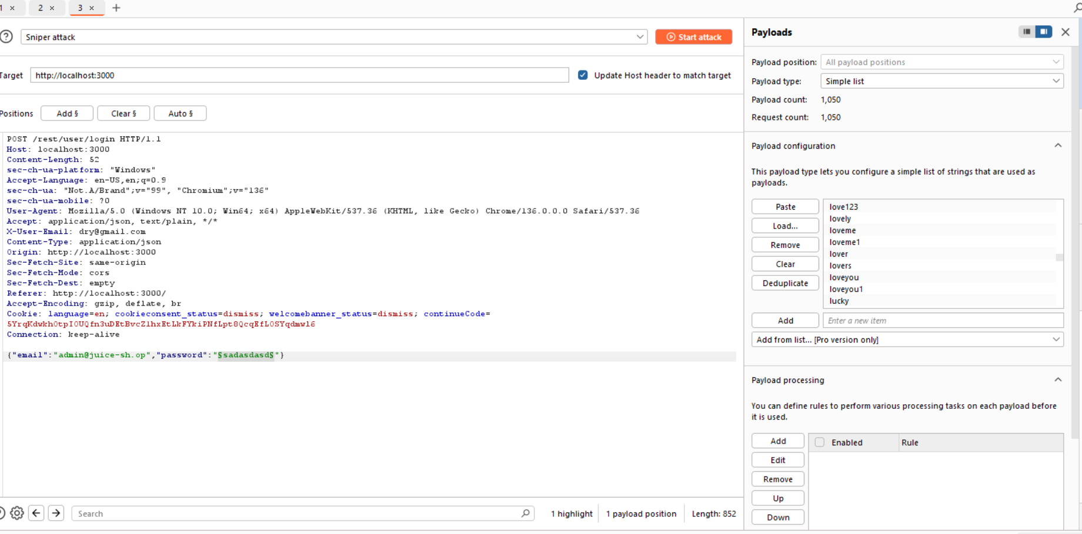

Slide 39
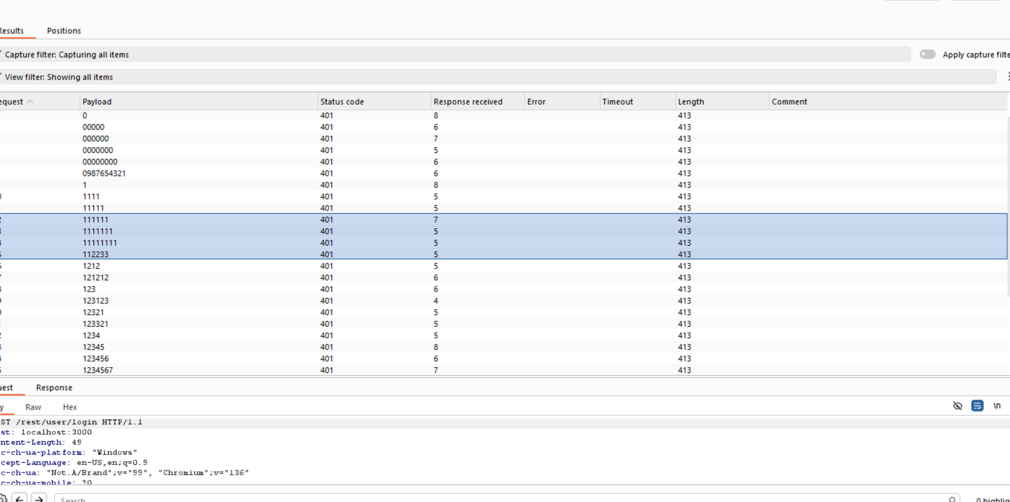

Slide 40
Broken Authentication – Reset Benders Password
Reset Bender’s Password via "Forgot Password"
Reset the password of the user Bender by correctly answering his security question:
“Company you first work for as an adult?”
Vulnerability
Security Question Exploitation (Weak Authentication via Public Info)
This is a classicexample of a weak account recovery mechanism, where the system allows password resets using a publicly available answer to a predictable security question.

Slide 41
steps
Identify the target user:
The challenge is about Bender, clearly referencing Bender from the Futurama TV series.
Research the answer to the security question:
Go to the Wikipedia article on Bender and check his biography.
It mentions Bender worked at a metalworking factory making suicide booths.
Further details on suicide booths (from the Futurama wiki) show the main company is Stop'n'Drop.
Answer the security question on the app:
Visit: http://localhost:3000/#/forgot-password
Use the email: bender@juice-sh.op
When asked "Company you first work for as an adult?", enter:
Stop'n'Drop
Reset the password
Enter any new password and confirm it.

Slide 42
Broken Authentication – Reset Bjoern’s password
Objective:
Reset the password of bjoern@juice-sh.op by correctly answering the security question:
"Your ZIP/postal code when you were a teenager?"
Vulnerability Type
Insecure Account Recovery using Public Information
Specifically, predictable security question answers, even with a twist of obscurity through historical format.

Slide 43
Steps
Identify the user:
The user “Bjoern” refers to Bjoern Kimminich, project leader of OWASP Juice Shop.
Find his teenage postal code:
His Facebook profile shows he’s from Uetersen, Germany.
A Gist or Pastebin entry mentions his area code 04122, confirming the town.
Check modern ZIP code (won’t work)
From geopostcodes.com, Uetersen’s ZIP is 25436.
Entering 25436 fails the challenge.
Find historical ZIP code:
Pre-reunification German ZIPs had different formats.
From alte-postleitzahlen.de, the old ZIP for Uetersen was
W-2082
Still incorrect.
Discover final correct format
Bjoern added obscurity by writing out the region prefix.
West-2082

Slide 44
Broken Authentication – Reset Jim’s Password
Objective:
Reset the password for the user jim@juice-sh.op by answering this security question:
“Your eldest sibling’s middle name?”
Vulnerability
Predictable Security Question + Public Information Exposure
This challenge leverages a weak account recovery mechanism where:
The security question is guessable
The user (Jim) is a public figure, and
The answer is easily found online or brute-forced using a list of common middle names.

Slide 45
steps
Go to the login page.
Enter: jim@juice-sh.op with a dummy password (e.g., test123).
Intercept the request in Burp Suite — this will show a 401 Unauthorized.
Send request to Intruder
Configure Intruder attack
Click Clear § to remove all automatic markers.
Highlight the value of the answer (or password) parameter.
Click Add § to mark it for payload injection.
Set payload options
Switch to the Payloads tab.
Set Payload type to Simple list.
Load a file containing common names (e.g., from SSA Baby Names List).
Click Start attack.
Monitor the HTTP status codes and response lengths.
Look for a 200 OK response (instead of 401).
In this case, the correct answer is Samuel.
9.Result:
Once you find Samuel gives a 200 response, use that as the answer in the Forgot Password form.
Set a new password and complete the reset.

Slide 46
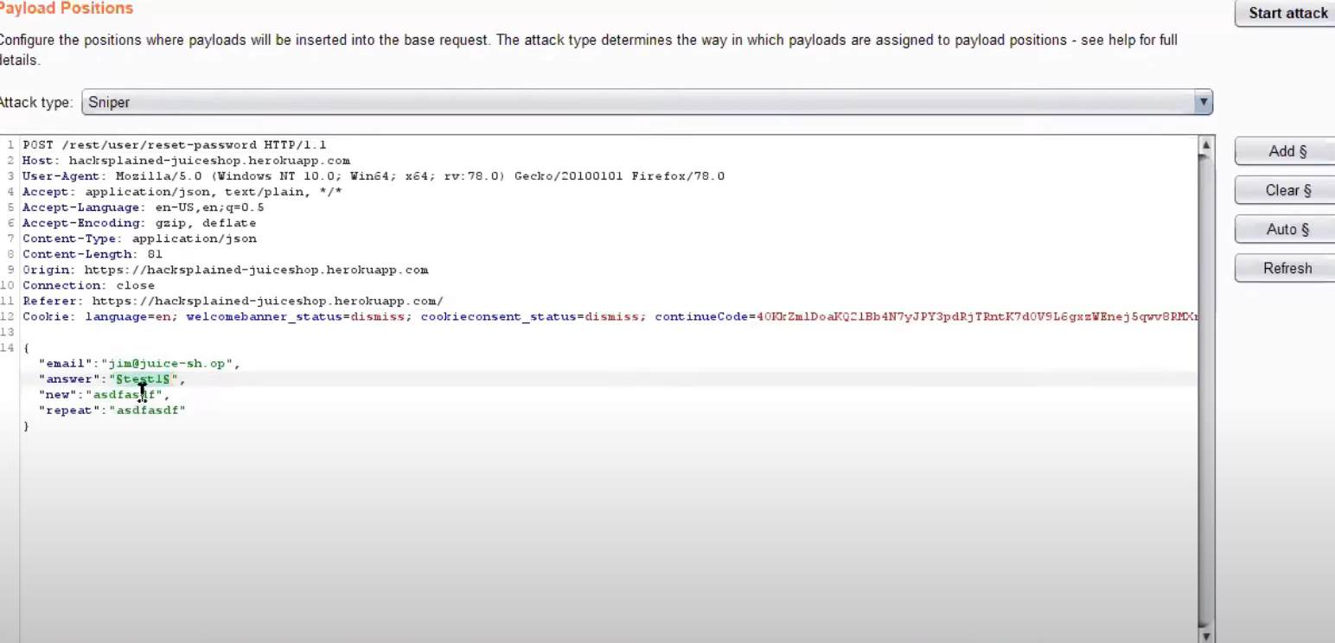

Slide 47
